Slide 1

Using Technology in Nursing Practice:
Part 2:
Optimizing Practice

Slide 2


Agenda
Nursing care with ICTs:
  Patient safety
  Using clinical judgement
  Advocacy
  Research

Slide 3
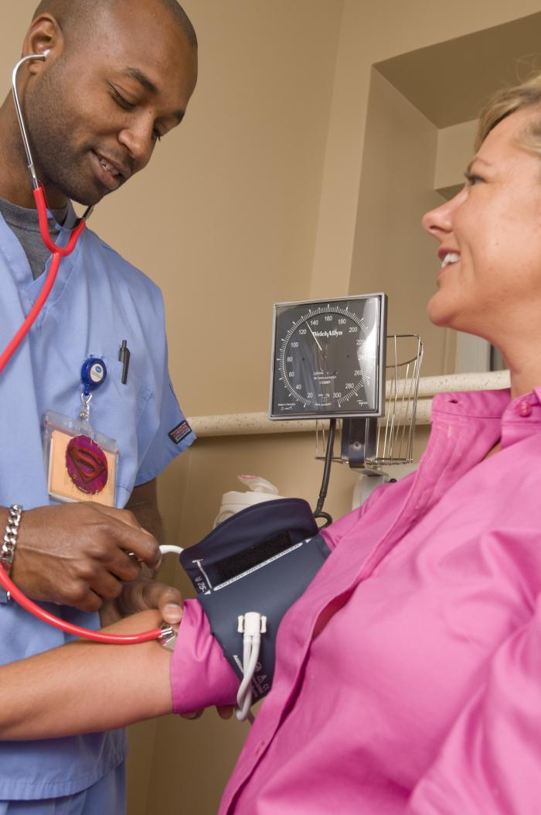
Nursing Care and the use of Health ICT
Patient Safety
2. Using clinical
judgement
3. Advocacy
4. Research
Notes:
ICTs present new opportunities for nurses to provide the highest quality of safe patient care

Slide 4
“It is a professional and ethical imperative for nurses to prevent or minimize harm”.
- Canadian Nurses Association, 2012
Notes:
Patient safety is a complex issue involving many facets of patient care. The use of information and communication technologies in care has many potentials to improve care, but if used incorrectly, can create instances where the safety of the patient is threatened.

Slide 5
Technology-induced errors11
Technology-induced errors and malfunctions may arise during the piloting and/or use of a new or existing health technology. However, patients/clients can be protected through prompt identification and reporting of such issues by nurses.

Slide 6

Nurses in Error Reporting 12
‘work-arounds’ → a term coined by Powell-Cope and colleagues to describe the quick fixes that nurses invent to temporarily solve the problem of a device malfunction or error
Although `work-arounds’ are an attractive way of dealing with technological issues, they can pose
            serious threats to patient
            care and safety
              Nurses needs to report malfunctions and errors as per their organization’s policies

Slide 7
Creating Safer ICTs 13
New technologies require an on-going process of design, piloting, evaluation and re-design to meet changing needs
On-going maintenance is a critical part of reducing errors at the individual-technology level
Notes:
Example of maintenance: Re-calibrating glucometer

Slide 8
Will technology replace nurses?
Notes:
*You could use this topic for a class:
-debate: divide the class and have them develop arguments for how technology will or will not replace nurses
-discussion: ask the question and give students time to respond. You may need to play the ‘devil’s advocate’ and argue for how evidence and technology could be used to plan care based on an algorithm
-essay: have students write a paper answering this question
This question leads into the importance of using clinical judgement with health information and communication technologies to ensure safe patient/client care

Slide 9
Technology & Clinical Judgement (14)
Clinical Practice Guidelines
Nursing Assessment
Health Technologies
Clinical Judgement
Health information and communication technologies should:
  Be a tool that supports nurses’ clinical judgement
  Not a replacement for it
Notes:
-Technologies can support clinical judgement by:
Providing point-of-care patient/client data for decision-making
Trending data to highlight positive or negative trends (e.g. fluid status in renal patient/client)
Allowing comparison of current assessment data with older data such as the assessment data collected in the ER upon first presentation
*This is a good lead into case study #2

Slide 10
Nurses as Advocates 9-10
Nurses act as advocates for their patients/ clients in working for their best possible health outcomes as defined by the individual
Health information and communication technologies present two ways for nurses to act as advocates:
  Supporting individualized care
  Facilitating integration of these technologies

Slide 11
Nurses as Advocates 9-10
Use of best evidence
Consideration of patient/client preferences
Notes:
While there is a lot of potential for improved patient/client care with increased access and use of the best evidence that is possible with new health information and communication technologies, there is also the potential for increased standardized (rather than individualized) care
Nurses need to be active in advocating for, and monitoring, this balance

Slide 12
Nurses as Advocates (9-10)
In light of the evidence that health information and communication technologies can improve patient safety, nurses need to be advocating for their use
What could you do as a nurse in your current or most recent clinical setting to advocate for the use of health technologies?
Notes:
*If the students are quiet, consider helping them focus their thoughts by asking:
-What could be done here, at this School of Nursing, to promote your use of health information and communication technologies when you are practicing as a RN? (answers could include: including use of technologies in labs to increase their experience and comfort with use, teaching them ways to use technology to support care)
-Let’s assume that your health facility is thinking of integrating a new health information and communication technology into patient/client care. In what ways could you be involved in this process? (answers could include: participating on planning committees, participating in piloting of the technology and documenting how it positively and negatively affected your practice)
-If your health facility is already using health information and communication technologies, how could you advocate for their use? (answers could include: documentation your use of them and their effects, reporting a lack of availability or need of updating to the proper authorities, requesting new technologies that will support care)
Other advocacy roles could include: participation in the updating of standard nursing terminologies used in electronic health systems (e.g. International Classification for Nursing Practice welcomes input from nurses)

Slide 13
Nurses as Researchers 9-10
Nurses can act as researchers on personal, organizational, and broader levels .
Acting as a researcher includes participation in research (e.g. collecting data, participating in focus groups, etc.) as well as designing and conducting studies.
Notes:
Nurses need to be involved in research related to health information and communication technologies to ensure that their viewpoint is represented in the work done on health information and communication technologies
If all nurses were full-time researchers, there would be no one to act on the evidence that was generated! All nurses can act as researchers by both participating in research and exploring the evidence to guide their care

Slide 14
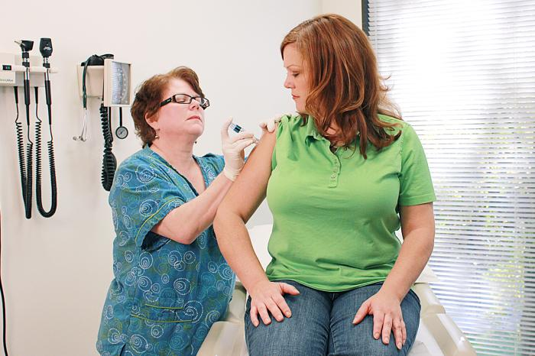
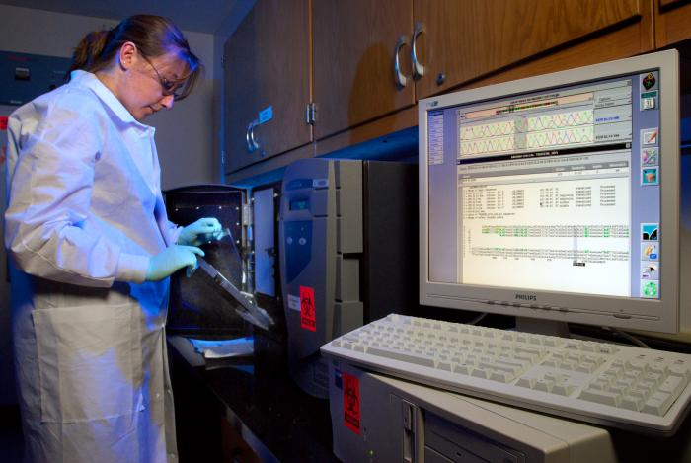


Nursing research can take many forms:
Notes:
Nursing research includes many different types of studies in many different types of settings and can involve nurses with both research and clinical expertise

Slide 15
Nurses as Researchers … 9
In order to be able to act as researchers, nurses need information literacy skills:
  Identifying an information need
  Accessing information relevant to the need
  Evaluating the information for quality and applicability
  Applying the information to the need
  Evaluating the outcomes
Notes:
-

Slide 16
Nurses as Researchers 9-10
On an organizational level, nurses can:
  Participate in quality-control studies involving health information and communication technologies
  Participate in piloting and evaluating the potential use of technologies in their workplace
  Recommend best practice guidelines for integration into clinical health systems that reflect the patients/ clients care for at the facility

Slide 17
Nurses as Researchers (9-11)
On a broader level, priority areas for nursing research include:
  The effect of nursing interventions on patient/ client outcomes as documented in EHRs
  The effect of using health information and communication technologies on the patient-/client-nurse relationship, use of clinical practice guidelines, etc.
  Identifying recommendations for the integration and use of health information and communication technologies based on literature reviews
  Identifying the cost-benefit ratio of specific technologies to support advocacy actions

Slide 18

Example Research:
Poe, S. (2011). Building nursing intellectual capital for safe use of information technology: a systematic review. Journal Of Nursing Care Quality, 26(1), 4-12
Results identified threats to
patient safety, competencies,
and supports needs for use
Notes:
This is just one example of the activity of nurses in researching the use, integration, and education around health information and communication technologies
As nurses perform skills that are different from those performed by other health care professionals, it is important that we are studying how to support our discipline in the integration and use of health information and communication technologies

Slide 19
Review of Main Points
New technologies present/legal and ethical issues that need to be addressed by policy
Legislation and policies relevant to privacy and health information have been created by the federal and provincial governments, nursing regulators and employers
Technologies present opportunities to increase patient safety and nurses have a large role to play in ensuring this occurs

Slide 20
References
Salzberg, C. A., Jang, Y., Rozenblum, R., Zimlichman, E., Tamblyn, R., & Bates, D. W. (2012). Policy initiatives for health information technology: A qualitative study of U.S. expectations and Canada's experience. International Journal of Medical Informatics, 81(10), 713-722.
Scott, R.E. (2007). e-Records in health – preserving our future. International Journal of Medical Informatics, 76(5-6), 427-431.
Office of the Privacy Commissioner of Canada. (2012). Legal information related to PIPEDA: Substantially similar provincial legislation. Retrieved from: http://www.priv.gc.ca/leg_c/ legislation/ss_index_e.asp
Office of the Privacy Commissioner of Canada. (2004). Findings under the Personal Information Protection and Electronic Documents Act (PIPEDA). Retrieved from: http://www.priv.gc.ca/cf-dc/2003/cf-dc_030217_2_e.asp
Information and Privacy Commissioner of Ontario. (2004, December). A guide to the Personal Health Information Protection Act. Retrieved from http://www.ipc.on.ca/images/ resources/hguide-e.pdf
Saskatchewan Registered Nurses Association. (2007). Standards and Foundation Competencies for the Practice of the Registered Nurse. Retrieved from: http:// www.srna.org/images/ stories/pdfs/nurse_resources/standards_competencies.pdf
Canadian Nurses Association. (2008). Code of ethics for Registered Nurses. Retrieved from http://www.cna-aiic.ca/cna/documents/pdf/publications/Code_of_Ethics_2008_e.pdf
Benson, T. (2012-0425). Principles of health interoperability HL7 and SNOMED (2nd ed. ed.). New York: Springer.
Ball MJ, Douglas JV, & Walker, PH. (2011). Nursing informatics, Where technology and caring meet (4th ed). London: Springer.
Saba VK, & McCormick, KA. (2006). Essentials of nursing informatics (4th ed). United States of America: McGraw-Hill Companies, Inc.
Borycki, E. M., Kushniruk, A. W., Keay, L., Kuo, A. (2009). A framework for diagnosing and identifying where technology-induced errors come from. Studies in Health Technology and Informatics, 148, 95-101.
Powell-Cope, G., Nelson, A.L., & Patterson, E.S. (2008). Patient care safety and technology. In Agency for Healthcare Research Quality (AHRQ Publication No. 08-0043). Rockville: MD.
Zhang, J.Patel, V.L., Johnson, T.R., & Shortliffe, E.H. (2004). A taxonomy of medical errors. Journal of Biomedical Informatics, 37 (3), 193-204.
Dumpel, H. (2005). Technology and patient advocacy: RNs must exercise independent judgement at all times. California Nurse, 101 (4), 18-19.

