Slide 1

Using Technology in Nursing Practice:
Part 1:
Complying with Policy

Slide 2


Agenda
Considerations for policy-makers
Policy for the protection of
personal health information:
  National, provincial/territorial,
  nursing association,
  organizational

Slide 3

Policy Challenges 1-2
Who should be able to access patient/client information?
How can or should that information be used?
How can personal health
information be transported
electronically without
compromising its safety?
How can personal health information be stored electronically in a safe and secure way?
Notes:
While technology and standard terminologies are moving forward in the development of electronic health records and clinical health system, policy also needs to be moving forward to ensure that personal health information is both kept safe and used to its fullest potential
Some challenges that policy-makers face include ... (proceed to questions on slide)
Acess – health care professionals within which health facilities? Doctors, nurses, physical therapists, social workers, dietitians, .... What about registered massage therapists? Chiropractors? Reflexologists? Etc.
Use– Probably to plan patient/client care, trend a patient’s/client’s health over time, but what about quality improvement studies within the health facility? Sharing of that information with other health facilities for a multi-site research study? Sharing that information with pharmaceutical companies trying to evaluate additional side effects of medications? Etc.
Transportation – can personal health information be accessed and transported electronically from a satellite office?
Storage – how and when do systems need to be backed-up? How frequently should users be required to change their passwords? Etc.

Slide 4

Considerations for Canadian Policy-makers1
Addressing:
  Variation in health care policies between different provinces and territories
  Variation in the electronic health records and clinical systems used across various provinces/territories and settings
Outlining policies in detail, but not stifling creativity
Engaging the right people
Notes:
In addition to those general considerations, policy-makers in Canada have some other considerations:
Differences in policy and organization of health care systems across the provinces and territories
Without mandating that all provinces and territories (and settings within each province and territory) use the same electronic system, policies need to be flexible in allowing for variations in these systems
Policies need to be specific enough that they are useful in guiding practices and decisions, but too much detail could prevent the use of innovative approaches
Good policy needs to reflect the needs of all involved parties – nurses, for example, need to be engaged in the creation of policy to ensure that it makes sense in nursing practice

Slide 5

Federal Legislation 3
Privacy Act
  -regulates use of information by the
  federal government
Access to Information Act
  -regulates use of information stored in government records
Personal Information Protection and Electronic Documents Act (PIPEDA) *
-regulates use of information by the private sector
*provinces and territories with privacy legislation considered ‘substantially similar’ to PIPEDA may be exempt
Notes:
Three Acts regulate how personal information can be accessed and used in Canada
Provinces and territories are able to either implement PIPEDA or develop their own similar legislation
Currently having their own version of PIPEDA are: British Columbia, Alberta, Québec, Ontario, New Brunswick, and Newfoundland and Labrador

Slide 6
Video: Overview of PIPEDA for Individuals
The following video outlines what PIPEDA means for individuals
It is an educational tool created by the Canadian Association of the Deaf - highlighting the educational opportunities that health information and communication technologies present for nursing
Insert video at: http://www.youtube.com/watch?v=5ePNbYJP7k4 (for English) or http://www.youtube.com/watch?v=HjUkkaUWHa8 (for French)

Slide 7

Real Life Example: Federal Legislation 4
PIPEDA Case Summary #2003-119: Employer's practice of collecting personal medical information to support a transfer request deemed appropriate
Complaint: An employee of a telecommunications company complained that his employer was attempting to collect more personal information about him than necessary in order to determine if he could be accommodated in another position for medical reasons.
Why does PIPEDA apply to this case?
What is your conclusion about the collection
and use of personal health information
in this situation?
Notes:
The details of this example can be found at: http://www.priv.gc.ca/cf-dc/2003/cf-dc_030217_2_e.asp
PIPEDA applies to this situation because telecommunications is a federal agency, and the agency is requesting collection and review of an employee’s personal health information
Overview of the situation (as outlined on the website): The investigation identified that the workplace’s policy outlined that the employee needs to consent for the workplace to receive personal medical information from his/her health care provider and that, based on medical information, employees will be assigned to areas that are compatible with their health needs. The employee went on sick leave in 2001 and consented to his family doctor sending information about his condition and his work capabilities to his workplace. The occupational health staff requested additional information as the employee’s doctor did not provide information on the employee’s prognosis for recovery and the employee had been moved to his current job within the workplace due to another that occurred injury several years ago. The workplace asked the employee to be assess by an independent general practitioner to gain additional information on his work capabilities. The employee complained that the workplace was trying to collect more information than was necessary in this second assessment.
*Ask: Is the company requesting the too much information or is the employee obstructing the workplace’s ability to better understand his health status for work placement?
Outcome (as per the website): In light of the workplace’s need to know prognosis in order to appropriately re-assign the employee, it was ruled that the employee’s complaint of his company requesting too much personal health information was not well-founded.

Slide 8
Nursing Example: Provincial Legislation 5
A registered nurse works for a private company involved in the manufacture of goods using chemicals that can be toxic to individuals after prolonged exposure. The nurse has been hired to regularly test employees of the company for levels of various toxins to determine whether it is safe for the employees to continue working under conditions where they are exposed to these chemicals. Once certain levels of toxins are detected in their blood, employees are transferred to other divisions of the company where there is no exposure to these chemicals. On a monthly basis, the nurse provides a report to the management of the company specifying whether it is safe for each employee to continue working under conditions of exposure. The information obtained by the nurse from testing of the employees is used for no other purpose.
Is the nurse subject to the Act [Ontario’s version of PIPEDA]?
Notes:
Details of this case study can be found at: http://www.ipc.on.ca/images/resources/hguide-e.pdf (page 5)
This Act defines ‘health information’ to include “information that relates to the provision of health care to individuals” (page 5)
*Ask: Is this a situation involving personal health information? Answer – yes, employee test results of toxin levels meet the definition
This Act applies to ‘health information custodians’ and ‘agents of health information custodians’
‘custodians’ - includes individuals delivering health care services for payment (regardless of whether the paying organization is publicly or privately funded)
‘agents’ – those working on behalf of a health information custodian (e.g. employees, volunteers, etc.) (page 5)
Is the nurse a ‘health care custodian,’ ‘agent,’ or neither in this situation? – Answer: the nurse is a health information custodian as she/he has access to personal health information (e.g. toxin levels) and provides health services (e.g. assessment of the occupational safety of the employees and intervention via recommendation for placement)

Slide 9
Provincial/Territorial Nursing Standards 6
Each provincial and territorial licensing body has its own standards which outline the necessity of nurses maintaining confidentiality
Example: Saskatchewan Registered Nurses Association: ‘Standards and Foundation Competencies for the Practice of Registered Nurses’: Standard III: Ethical Practice
“80. Understands ethical and legal considerations in maintaining client confidentiality in all forms of communication: written, oral, and electronic.”

Slide 10
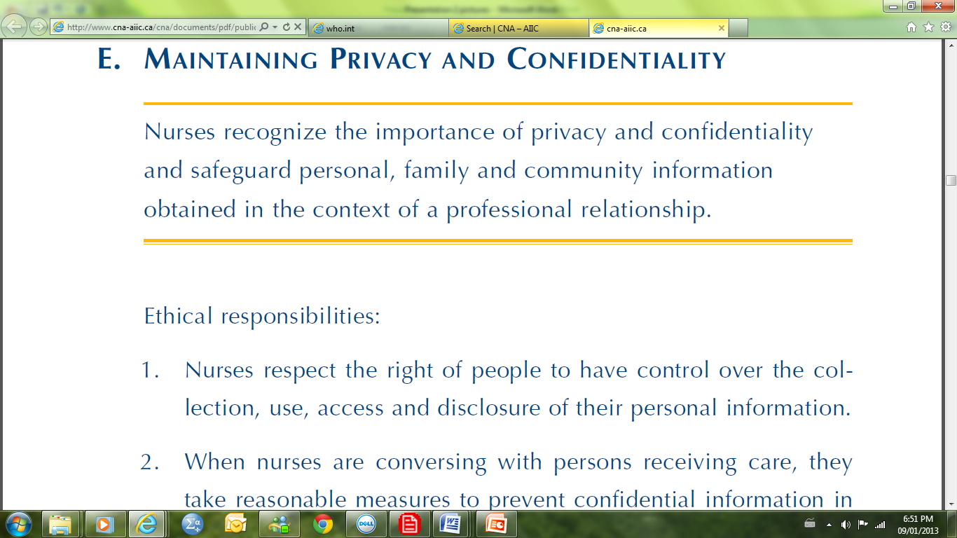
National Nursing Standards 7
Canadian Nurses Association:
  Code of Ethics for Registered Nurses (2008)
Notes:
If you read the standard, it explicitly mentions safeguarding patient’s/client’s personal information stored in an electronic format in additional to reminding nurses to comply with organizational policies around confidentiality

Slide 11
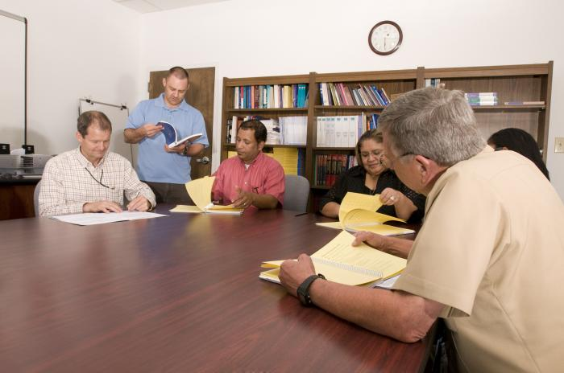
Organizational Policies 8
Each organization will have to develop their own policies to ensure that they are meeting the national and provincial/territorial standards
Policy points include:
  Definition of ‘personal’
  Protecting access
  Off-site access
  E-mail of information
Notes:
Each organizational setting is responsible for ensuring that they are complying with federal and provincial/territorial requirements as they apply to their setting
Nurses are responsible for learning the workplace’s policies regarding the safe use of personal health information and health information and communication technologies
Depending on the setting and means by which personal health information is stored (e.g. hardcopy vs. electronic charts), policies may be needed for:
“personal information” – a public health facility may be responsible for reporting the number of occurrences of some communicable diseases, and will need policies to guide how to report this information while protecting identifying details
Access – each organizational will have to determine which staff members require access to personal information and how that access is safeguarded (e.g. Password, authorization process, etc.)
Off-site/home-access – depending on the facility, staff such as a home care nurse may be required to access and document personal information off-site, and policies will be needed to guide this process such that personal information is protected
Electronic transport of data – depending on the communication systems used by the organization, policies will need to be developed to ensure that personal information is protected during electronic transit
*the specific policy points listed on a slide like this can be tailored to your specific site – for example, are patients/clients referred to your associated health care facilities from other areas and thus require policies for how personal health information is handled on admission and discharge? Are there special groups of patients seen at your facilities (e.g. Inmates, local celebrities, etc.) that may require additional policy for how their personal information is handled?

Slide 12
Video: Privacy & Policy
Insert video at: http://www.youtube.com/watch?v=Jq_fqDLgHxc
(real-life examples used to identify privacy issues with health information and communication technologies)

