Slide 1

Information and Communication
Technologies in Nursing: Types, Uses, & Benefits

Slide 2
Agenda
Three main types of electronic systems
  Point-of-care (e.g. electronic medical records)
  Electronic health records
  Consumer health solutions (e.g. personal health records)
Optimizing Care Delivery using ICT
  Virtual & Mobile healthcare
  Documentation
  Decision support at the point-of-care
  Improving inter-professional care
  Supporting the nurse-client/-patient relationship

Slide 3
3 Types of Electronic Systems 1
1. Point-of-care systems (e.g. EMR)
allow entry and viewing of data within an organization
Electronic Health Records
allow data entry and viewing across multiple services and across a lifetime
Consumer health solutions (e.g. PHR)
enables the patient/client to enter, review, and share personal health information
Notes:
Note: EMR – electronic medical record, PHR – personal health record

Slide 4
Electronic Medical Records (EMRs) 2-3
Same idea as a patient’s/client’s hardcopy medical chart
Used within one health care facility (e.g. An acute care hospital) or team (e.g. primary care team)
Include documentation, medical history, medications, and diagnostic and imaging reports related to one facility or team

Slide 5
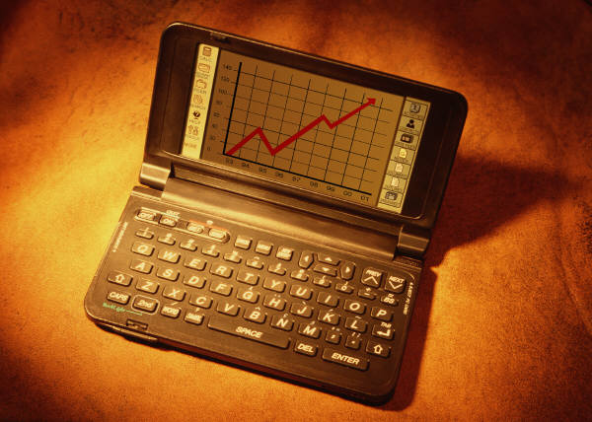
Benefits of EMRs 3-4
Easy and quick documentation and access to patient/client information
Improved monitoring by trending and tracking health information
                Access to clinical guidelines and tools
                Tool for health teaching
                Research opportunities: quality improvement and care planning
Notes:
Documentation and access to information: EMRs eliminate the issues of pens running out, papers falling out of charts and getting lost, trying to read messy hand-writing, etc.
Monitoring: similar to EHRs, EMRs allow information such as weight to be tracked and interventions or tests initiated as necessary
Access to tools: similar to EHRs, EMRs can have clinical practice guidelines and clinical cools (e.g. An electronic CPS that can identify potential interactions between medications)
Health teaching: the screen can be used to show a patient/client their information or test results to improve their understanding of their health
Research opportunities: quality improvement such as tracking how frequently recommendations from clinical practice guidelines are used, and care planning such as how many minutes on average are needed per patient/client for a six-week check up following the delivery of a new mother

Slide 6
Electronic Health Records (EHRs) 5-6
Definition: “an electronic record that provides each individual in Canada with a secure and private lifetime record of their key health history and care within the health system.” (Canada Health Infoway Blueprint, p. 5)
These records allow nurses, pharmacists, therapist, doctors, and other members of the health care team to view and update a patient’s/client’s health record
Currently, Canadian stakeholders are working towards implementing electronic health records for each province and territory
Notes:
*depending on the amount of clinical experience the students have had, some students may be willing to share their experience using EHRs with their peers

Slide 7
Basic EHR Components 5-6
Point-of-care system for data entry and retrieval
Functionality
  Client registry (e.g. personal information)
  Provider registry (e.g. home care nurse)
  Diagnostic imaging system (e.g. x-ray)
  Drug information system (e.g. current meds)
  Laboratory information system (e.g. blood-work)
  Medication profiles
  Clinical reports (e.g. discharge summary)
Interoperability
Notes:
On a basic level, EHRs need to have these core elements
Each province and territory is responsible for developing an EHR that both meets their unique needs and adheres to a basic standard of components
According to these core elements, all EHRs need to list both clients and the health care providers involved in their care; access to images (e.g. X-rays, CT scans, etc.) and lab reports (e.g. INR, Pt, Ptt, etc.); current and prior medications and allergies; and it needs to be accessible and useable by all types of health care providers involved in the individual’s care - interoperability
Interoperability refers to the fact that EHR need to be accessible to multiple different health professionals across multiple health settings such that everyone involved in the individual’s care can document and communicate their assessment and actions
Without interoperability, the health care team members are not able to communicate with each other through the EHR, and the whole point of having one place for all of the individual’s health care data is lost

Slide 8

Advantages of EHRs 5-7
Legibility
Availability
Ease of updating
Storage
Improved patient safety
Notes:
There are multiple advantages of having electronic health records:
Legibility
-unlike hardcopy records, electronic health records do not depend on an individual’s hand-writing or signature to be readable
-this can be especially important in situations where medication names differ by one or two letters (e.g. “antacid” and “atacand”)
Availability
-hardcopy charts may not be time effective – for example, two health care professionals could easily need the same chart at the same time OR a chart sent with a patient to imaging for a test may return to the floor without their chart, OR a chart may be returned to the wrong place and cause a nurse (or other health care professional) to waste time in trying to locate the chart, etc.
Improved patient safety
-for example, electronic charts complete with a patient’s/client’s allergies may alert health care professionals trying to prescribe or administer a contra-indicated mediation
4. Ease of updating
-because of the electronic nature of EHRs, all health professionals have instant access to any added information
-for example, if a respiratory therapist suggests that an individuals needs to be switched from oxygen via nasal prongs to oxygen via a face mask, all other health professionals can see this information as soon as it is entered
Storage
-EHRs prevent large quantities of papers from having to be stored, sent with clients/patients if they move or are sent to another facility, and prevent papers from potentially becoming lost
*Ask: What are some other advantages that you can think of?
-allowing for easy trending of patient/client data (e.g. Weight, blood pressure, etc.)

Slide 9

Challenges of EHRs 5
Upfront costs
Collaboration of
expertise
Protecting privacy
Notes:
Cost
-between 2001 and 2009, the Canadian federal government has spent approximately 1.2 billion dollars on this initiative, and it is still underway
-once in place, EHRs are estimated to save 6 billion dollars per year
Collaboration
-in order to design an effective electronic health record, expertise is needed in clinical, technological, organization, and ethical areas to name a few
Protecting privacy
-each province is at different stages in implementing EHRs
-Manitoba’s EHR, for example, requires users to login and has a built-in audit trail and protection to prevent unauthorized users from accessing an individual’s health information; there is also work underway with regards to maintaining confidentiality while accessing EHRs on mobile devices

Slide 10
EHRs in Canada
Show video available at: http://www.youtube.com/watch?v=b74_jcyqkM4

Slide 11

Help
Patient Details
GP Details
Logout
1234567
Smith,
Carolyn
Sex: Female
DOB: 01/May/1946
Next of Kin: John Smith
Phone: 365-423-9007
Address: 19 Provincial Rd.
Edmonton, AB, T6M 1R7
Name: Jones, Evans Phone: 365-423-9886
Address: 11 Terrance Ave, Edmonton, AB, T6M 1N5
Other Health Care Providers
Name Specialty Contact Access
Diaz, Ellen Cardiology 365-423-5545 Y
McDonald, Janice RN 365-423-9886 Y
Cohen, Richard Dermatology 365-423-5123 Y
Patient Record:
Lab Results
Diagnostics
Images
Details
Notes
Medications
Name Started Last Filled
Hydrochlorothazide 25 mg 12/1989 01/2013
Glyburide 5 mg 06/1996 12/2012
Metformin 500 mg 12/1996 12/2012
Cloxacillin 500 mg discontinued
Alerts:
Allergy – Sulfa drugs
Pap smear due
AtC above target
Diagnoses (Date) Status
Hypertension (1989) On-going
Diabetes (1996) On-going
C-section (1967) Resolved
Encounter History
Name Specialty Facility Reason
Jones, E GP annual physical
Cohen, R Dermatology Skin clinic mole removal
McDonald,J RN DM teaching
Notes:
This is sample of what a basic EHR might look like

Slide 12
Nursing Opportunities with EHRs 5
EHRs provide nurses with an opportunity to:
  Work with other health professionals towards optimal, collaborative patient/client care, and
  Systematically document their interventions and the resulting outcomes
In order to do this, nurses need to use standardized nursing and clinical terminologies
Notes:
Having interoperable EHRs allows for nurses to interact with health professionals across single organizations and health care systems
Documentation of nursing interventions and outcomes adds visibility to nurses and demonstrates the value in what nurses do and allows for studying of which interventions are effective and which may be ineffective in achieving desired outcomes
Nurses across Canada and the globe need to be able to communicate with each other and with other health professionals in a clear way – standardized terminologies facilitate this communication

Slide 13

Patient/Client Benefits with EHRs 5-6
care during medical emergencies
monitoring and management of chronic diseases
wait times for diagnostic, screening or treatment procedures
use of diagnostic or screening results with reduced unnecessary repetition
diagnosis and treatment with
information sharing
access for rural groups
Notes:
Medical emergencies: EHRs allow emergency room health care professionals to access vital information such as current medications, chronic diseases, and allergies that allow for faster and informed diagnostic and treatment decisions
Monitoring and management: EHRs allow health care professionals to track and trend information such as blood pressure across time which can aide in deciding whether current treatment is effective
Wait times: patients/clients are able to learn about wait-times at different facilities and have their health information easily shared with other facilities
Avoiding repetition: having access to a patient’s/client’s health record prevents unnecessary testing as recent test information is available – this reduces both health care costs and risks to the patient/client
Diagnosis & treatment: EHRs allow for consultation and collaboration with health professionals at multiple sites
Access for rural groups: use telecommunications and EHRs allows for consultation and follow-up with specialists without the patient/client having to drive to an urban centre

Slide 14
  *Show videos on Canada Health Infoway website:
  https://www.infoway-inforoute.ca/index.php/progress-in-canada/knowing-is-better/knowing-is-better-for-canadians/knowing-the-benefits

Slide 15

Let’s Play ‘Jeopardy’
Possible questions include:
“What is an EMR/Point-of-Care System?”
Or
“What is an EHR?”
*adapted from Canada Health Infoway Jeopardy Quiz: EMR or EHR?
Notes:
To check your understanding, we’re going to play Canada Health Infoway Jeopardy
To help you, there are only two possible questions you can ask: “What is an EMR” or “What is an EHR?”
*you may need to explain that ‘Jeopardy’ is a televised game-show where contestants are given an answer and they need to provide the appropriate question
*if you have access to iClickers or similar technology that allows students to electronically respond to questions, this would be a perfect opportunity to use them

Slide 16

I can only see the medications prescribed in my facility for this client/patient.
I can see the laboratory test results ordered by my acute care facility and those ordered at the patient’s/client’s primary care facility.
I see the condition and problem lists from all the clinicians in the patient’s/client’s circle of care.
I can view my clinical notes for all encounters the patient has had with me as a nurse.
            I can view all of the current medications by all clinicians prescribed for this patient.
Notes:
Answers: 1 – EMR, 2 – EHR, 3 – EHR, 4 – EMR, 5 - EHR

Slide 17
I can see the patient’s diagnostic imaging report and the image.
I can see a history of the patient’s encounters with the healthcare system.
I can see the laboratory test results ordered at my facility or copied to my facility.
I can see consultant reports as a result of an
e-referral I made to spiritual care.
I can see discharge reports from prior hospital
admissions that the hospital sent to my facility.
I can see a history of a patient’s hospitalizations
and discharge reports.
Notes:
Answers: 6 – EMR, 7 – EHR, 8 – EMR, 9 – EMR, 10 – EMR, 11 - EHR

Slide 18
Personal Health Record (PHR) 3,8-9
Includes information added by the individual
Less comprehensive than an EHR, similar in scope to an EMR but includes different health information
May be an isolated document, but ideally is integrated and overlaps with an EHR
Notes:
-PHRs are an example of a consumer health solution
*Ask: Do you think all patients/clients would want to have a PHR? Why or why not?
*Ask: What characteristics do you think make a patient/client more or less likely to use a PHR?

Slide 19
Assessment and Teaching for PHRs 3,8-9
Health literacy
Health teaching :
  understanding the information contained in the PHR
  what information is important to document in the PHR
Basic teaching about how to access and use a PHR
*Some barriers cannot be directly changed such as socioeconomic and health statuses.
Notes:
Health literacy: individuals may be likely to use a PHR if they are unable to understand the health information and health teaching integrated into the system. A potential role for nurses is the assessment of a patient’s/client’s health literacy to identify whether further teaching is necessary before expecting an individual to use, and benefit from, a PHR
Health teaching: individuals may be need specific health teaching about information in their PHR that is relevant to their health (e.g. normal ranges for blood sugar testing), and may need instruction in what health information will be helpful in informing health care professionals about their health status
Depending on the patient’s/client’s comfort level with, and access to, health information and communication technologies, nurses may need to do some teaching of basic computer skills
Other personal factors have been associated with use of PHRs – although a nurse cannot change a patient’s/client’s socioeconomic status, he/she can be aware of individuals who may require additional support to optimize their use of a PHR

Slide 20

Benefits of PHRs 3,8-9
Supporting self-management
Improves communication between a patient/client and health care professionals
Allows for personalized health teaching
Notes:
Self-management: PHRs allow individuals to track and record their symptoms, and can include alerts and reminders (e.g. refilling prescriptions, when to book an appointment, etc.)
Communication: allows patients/clients to record symptoms and dietary supplements/natropathic medications for quick retrieval at an appointment instead of the patient/client having to remember symptoms, dates, names, doses, etc.
Health teaching: PHRs can integrate health information specific to the information entered by the patient/client (e.g. Dietary changes to reduce blood pressure for someone whose blood pressure has been slowly increasing)

Slide 21

Using ICTs to Optimize Patient Care2,4
Mobile/virtual care delivery
Improved documentation
Decision support at the point of care
Preventing gaps in patient care
New opportunities for
inter-professional care

Slide 22
Virtual Health:
Health professionals deliver care from a different location than the patient
Mobile Health:
The use of wireless tools to deliver and access virtual care and/or health information

Slide 23
Mobile Health10
Nurses can use devices to communicate, share information and monitor health
Patients receive convenient care and increase their role in managing health
Examples of mobile health
  Email for perscription renewal
  Health-related apps (e.g. bant app)
“There’s an app for that!”
Notes:
The bant app was developed by the University Health Network in collaboration with Sick Kids Hospital. The app connect’s the patient’s iPhone to their blood sugar monitor and stores data, allows entry of nutrition notes, and connect to other young people with diabetes through social networking.

Slide 24
Virtual Health10
Has the potential to replace in-person visits (e.g. follow up visits after a medical procedure completed using mobile device)
Manner of providing care in remote locations
Cost saving and convenient

Slide 25
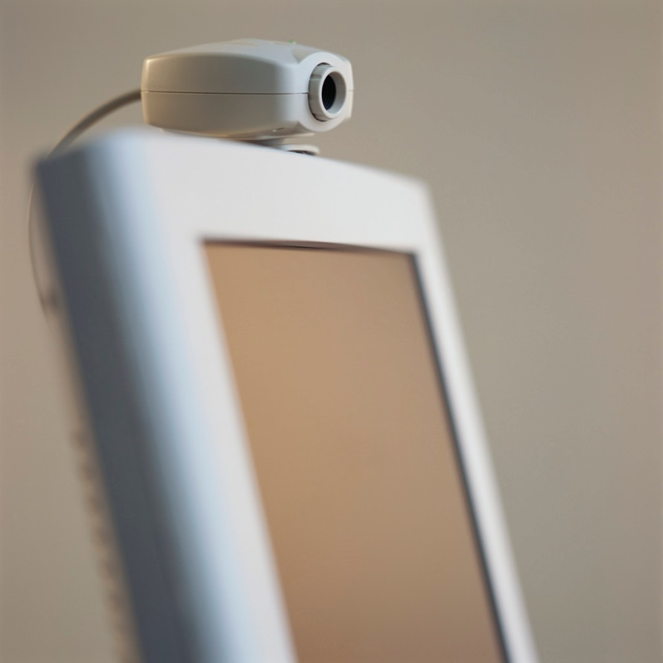
Telehealth 3,11
Uses telecommunication devices to provide patient/client care, education, and health administration to remote sites
3 main solutions:
Live conferencing
Store-and-forward
Telemonitoring
Notes:
-Telehealth presents another form of health information and communication technology that can be used in the provision of patient/client care
Live conferencing – allows visualization of, and discussion with, remote individuals; the addition of telemonitoring devices allows health care providers to expand their assessment to include things like vital signs and listening to heart and breath sounds
Store-and-forward – information is recorded in real-time and then can be retrieved and reviewed at a later time from a remote site
Telemonitoring – allows clinical data to be collected and transmitted to remote sites
*Ask: What are the benefits of telehealth? (responses may include decreased travel for patients/clients, access to specialized services in remote areas, consultation between remote health care providers, etc.)

Slide 26

Advantages of Documentation in EHRs 2,4
Improved detail by having documentation templates prompt information to be added
Improved accuracy of documenting by point-of-care access
Decreased redundant charting
due to auto- populating of
fields with pre-entered data
Notes:
Templates: With documentation templates, nurses and other clinicians can be prompted to document specific information that could otherwise be forgotten or missed (e.g. Smoking history for an individual being assessed for COPD)
Accuracy: documentation at the point-of-care allows details to be recorded immediately, the additional access to clinical practice guidelines allows for easy access to recommendations for assessment and interventions
Redundant charting: information entered on admission (e.g. age, baseline GCS score, etc.) can be automatically added through the chart where appropriate without having to be re-measured or re-asked of the patient/client

Slide 27

Advantages of Documentation in EHRs 2,4
Ability to assess gaps in care
Decreased nursing time
                Increased communication via
                real-time and legible documentation
Notes:
Gaps: by reviewing a patient’s/client’s information, adverse reactions or preferences can be identified and integrated into future care decisions/actions
Time: although there is a lot of variability, there is evidence that nursing time can be decreased through the electronic documentation. This time difference will also likely increase as EHRs become commonplace
Communication: without the difficulty of reading hand-writing or trying to ‘find’ a chart or a specific piece of information in the chart, communication between nurses and other disciplines can be improved

Slide 28
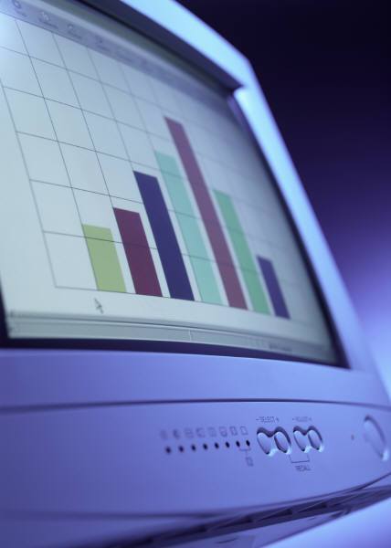
Decision Support at the Point-of-Care 2,4
Nurses are able to access a wealth of
information at the point-of-care to support
critical thinking and decision-making
In order to realize this advantage, nurses
should:
Become familiar with how to access and manipulate (e.g. trend) information
Use critical thinking to plan care and act based on all the information available
Advocate for the integration of relevant clinical practice guidelines
Notes:
Example: A nurse who checks on a patient/client and finds him/her drowsy and difficult to rouse may be able, at the point of care, to trend blood work and glucometer test results, check which medications the patient/client has been administered, review the health history for any similar events, identify when the patient/client was last documented as being alert, and identify which members of the health care team are responsible for this patient's/client's care.

Slide 29
Prevent Gaps in Care 2,4
Due to interoperability, clinical findings and concerns can be recorded and viewed by all authorized health team members
In order to improve continuity of care, nurses should:
Clearly document their clinical findings and concerns
Consulting other health care professionals to address concerns
Notes:
Example: A nurse engaging in health teaching for a new mother and newborn who are going to be discharged later that day can document concerns about family dynamics and nutrition that will record pertinent information for social workers and public health nurses who will be providing care to this family after discharge.

Slide 30

Decreased Missed/Late
Assessments or Interventions 2,4
Alerts or reminders may be included in EHRs based on clinical guidelines, medication record, or monitoring devices (e.g. Cardiac monitor)
In order to prevent missed or late actions, nurses should:
Include patient/client preferences
Use alerts/reminders to support
(not replace) critical thinking
Advocate for the addition of alerts
or reminders that would improve
patient/client care
Notes:
Example: A nurse looking after a patient/client with increased intra-cranial pressure may be alerted to high levels of pressure as detected by an intra-ventricular catheter and recorded in the EHR or clinical health system to improve timely intervention, or reminded to give a medication at a specific time.

Slide 31
Interprofessional Patient Care14
Improved communication between team members
Increased quality and accuracy of information
Increased opportunity for interprofessional collaboration

Slide 32
EHRs and Therapeutic Relationships 12-13
There is potential for clinical systems like EHRs to both support and hinder the nurse-patient/ -client relationship
What are ways that EHRs can hinder this relationship?
What are ways that EHRs can support this relationship?
Notes:
Ask the students to think of ways that EHRs can help or hinder the nurse-patient/-client relationship
Hinder: decreasing eye-contact by looking at the screen, focusing too much on the evidence and practice guidelines on the screen to the neglect of the individual’s preferences
Support: use EHRs as a tool for health teaching, engaging the individual in their care by having the screen as a visual way of representing their health

Slide 33
Increase or Support Patient/Client Involvement in Care 2,4
Use of trending and integrating EHRs with PHRs allows for increased participation of the patient/client in their health
In order to support this involvement, nurses should:
Teach specific self-management activities
Provide on-going support as challenges arise
Recommend seeking professional care when a health concern requires professional intervention
Notes:
Example: A community care access centre nurse caring for a family with a young child who is severely physically and cognitively challenged may follow the mother's documentation in the child's personal health record and note that the child is presenting with symptoms consistent with a bladder infection and recommend to the mother that the child see his/her physician or nurse practitioner for diagnosis and treatment.

Slide 34
Recommendations to Support the
Therapeutic Relationship 12
Connect
  Use eye-contact, names, ask about symptoms instead of relying on what has been recorded, etc.
Collaborate
  Ensure the screen is not hidden, ask permission to document during the interaction, explain what you are doing when you access information in the EHR, ask the patient/client for their thoughts on the information, etc.
Close
  Remind the patient/client about privacy of information, review main findings, finish with eye-contact, etc.

Slide 35

Avoid complaining about technology
to the patient or client!! 12
Notes:
And as a general rule ....

Slide 36
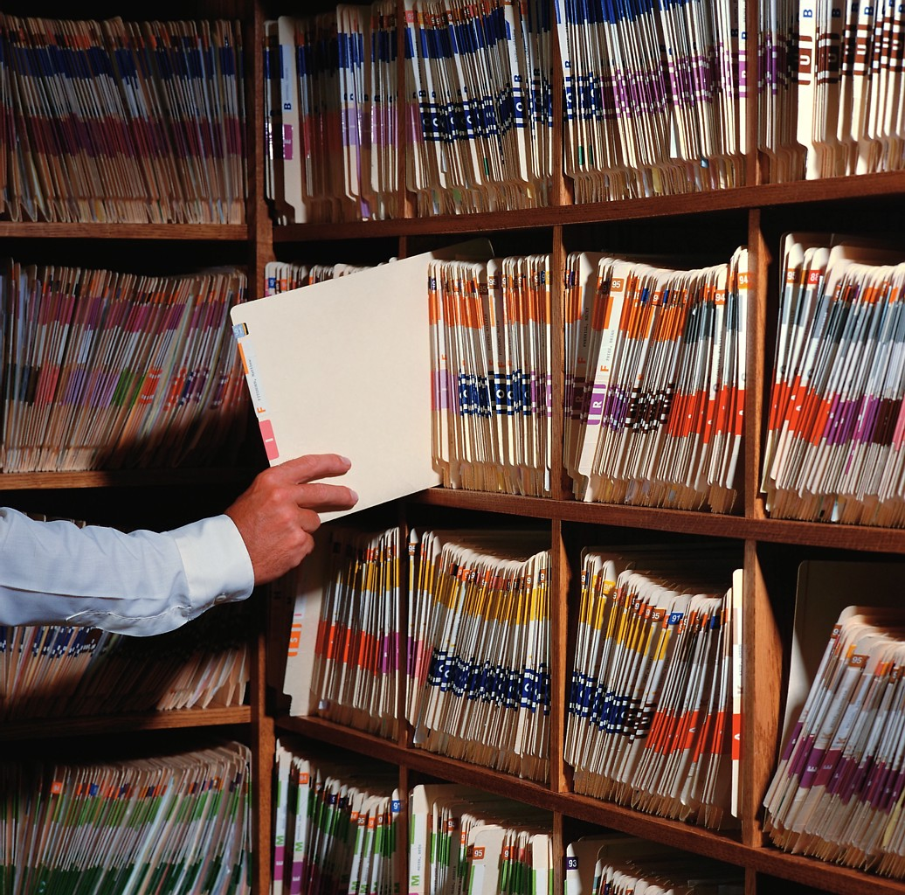
Review of Main Points
Point-of-care systems, EHRs, and consumer health solutions are 3 different types of electronic systems that vary in scope, access, and
advantages
ICT devices
provide opportunities to
improve access to health resources
in remote locations
ICTs can be
delivery of patient care through:
  Mobile/virtual care delivery
  Improved documentation
  Decision support at the point of care
  Preventing gaps in patient care
  New opportunities for inter-professional care

Slide 37
References
Canada Health Infoway. (2013). Retrieved from: https://www.infoway-inforoute.ca/
Canada Health Infoway. (2012a). Benefits to clinicians. Retrieved from https://www.infoway-inforoute.ca/index.php/progress-in-canada/knowing-is-better/knowing-is-better-for-clinicians/benefits-to-clinicians.
Saba, V. K. & McCormick, K. A. (2006). Essentials of nursing informatics (4th ed). New York: McGraw-Hill, Medical Publishing Division.
Ball, M. J., Douglas, J. V., & Hinton Walker, P. (Eds.). (2011). Nursing informatics where technology and caring meet (4th ed). London ; New York: Springer.
Office of the Auditor General of Canada. (2010). Electronic health records in Canada. Retrieved from http://www.oag-bvg.gc.ca/internet/docs/parl_oag_201004_07_e.pdf
Canada Health Infoway. (2005, March). Pan-Canada electronic health record executive summary. Retrieved from: https://www.infoway-inforoute.ca/ .../83-canada-health-infoway-s-10-year-investment-strategy-executive-summary. (OLD 1)
Canada Health Infoway. (2012a). Benefits to clinicians. Retrieved from https://www.infoway-inforoute.ca/index.php/progress-in-canada/knowing-is-better/knowing-is-better-for-clinicians/benefits-to-clinicians.
Detmer, D., Bloomrosen, M., Raymond, B., & Tang, P. (2008). Integrated personal health records: Transformative tools for consumer-centric care. [null] BMC Medical Informatics & Decision Making, 8(1), 45.
Kupchunas, W. R. (2007). Personal health record: New opportunity for patient education. Orthopaedic Nursing, 26(3), 185-193.
PriceWaterhouseCoopers. (2013). Making care mobile: Shifting perspectives on the virutalization of healthcare. Retrieved from www.pwc.com/ca/virtualcare
Canada Health Infoway. (2011). Telehealth benefits and adoption: connecting people and providers across Canada. Retrieved April 2, 2013 from https://www.infoway-inforoute.ca/index.php/programs-services/investment-programs/telehealth.
Baker, L. H., Reifsteck, S. W., & Mann, W. R. (2003). Perspectives in ambulatory care. connected: Communication skills for nurses using the electronic medical record. Nursing Economic$, 21(2), 85-88.
Petrovskaya, O., McIntyre, M., & McDonald, C. (2009, July/September). Dilemas, tetralemmas, reimaginig the electronic health record Advances in Nursing Science, 32(3), 241-251.
Hammet, L., Harvath, T., Flaherty-Robb, M., Sawyer, G. and Olson, D. (2007). Remote Wound Care Consultation for Nursing Homes: Using a Web-Based Assessment and Care Planning Tool. Journal of Gerontological Nursing, 33(11), 25-37.

